Slide 1




Slide 2

Contents
REQUSET
RESPONSE
게시판
게시판보완

Slide 3
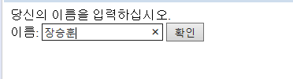
Requset 이해
<HTML>
<HEAD>
<%@ page language="java" contentType="text/html; charset=UTF-8" pageEncoding="UTF-8"%>
<TITLE>이름 입력</TITLE>
</HEAD>
<BODY>
당신의 이름을 입력하십시오.
<FORM ACTION=hi.jsp METHOD=GET>
이름: <INPUT TYPE=TEXT NAME=YOURNAME>
<INPUT TYPE=SUBMIT VALUE='확인'>
</FORM>
</BODY>
</HTML>

Slide 4
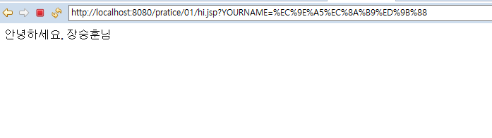
Requset 이해
<%@ page language="java" contentType="text/html; charset=UTF-8" pageEncoding="UTF-8"%>
<HTML>
<HEAD><TITLE>인사하기</TITLE></HEAD>
<BODY>
안녕하세요, <%= request.getParameter("YOURNAME") %>님
</BODY>
</HTML>
Start

Slide 5
Requset 이해
<HTML>
<HEAD>
<%@ page language="java" contentType="text/html; charset=UTF-8" pageEncoding="UTF-8"%>
<TITLE>이름 입력</TITLE>
</HEAD>
<BODY>
당신의 이름을 입력하십시오.
<FORM ACTION=hi.jsp METHOD=GET>
이름: <INPUT TYPE=TEXT NAME=YOURNAME>
<INPUT TYPE=SUBMIT VALUE='확인'>
</FORM>
</BODY>
</HTML>

Slide 6
Requset 이해
<HTML>
<HEAD>
<META http-equiv="Content-Type" content="text/html;charset=euc-kr">
<TITLE>게시판 글쓰기 - 입력 화면</TITLE>
</HEAD>
<BODY>
<H2>글쓰기</H2>
<FORM ACTION=BBSPost_new.jsp METHOD=POST>
이름: <INPUT TYPE=TEXT NAME=NAME><BR>
제목: <INPUT TYPE=TEXT NAME=TITLE><BR>
<TEXTAREA COLS=30 ROWS=5 NAME=CONTENT></TEXTAREA><BR>
<INPUT TYPE=SUBMIT VALUE='저장'>
</FORM>
</BODY>
</HTML>
Start

Slide 7
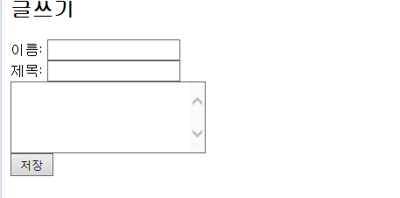
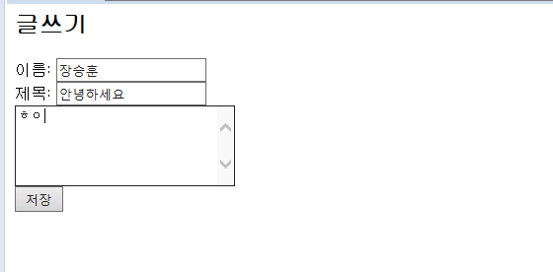
Requset 이해
NAME에는 장승훈
TITLE에는 안녕하세요
내용에는 ㅎㅇ가 저장된다

Slide 8
Requset 이해
<%@page contentType="text/html; charset=euc-kr"%>
<%@page import="java.io.*, java.util.Date"%>
<%
request.setCharacterEncoding("euc-kr");
String name = request.getParameter("NAME");
String title = request.getParameter("TITLE");
String content = request.getParameter("CONTENT");
Date date = new Date();
Long time = date.getTime();
String filename = time + ".txt";
String result;
PrintWriter writer = null;
Start

Slide 9
Response 이해
String filePath = application.getRealPath("/WEB-INF/bbs/" + filename);
writer = new PrintWriter(filePath);
writer.printf("제목: %s %n", title);
writer.printf("글쓴이: %s %n", name);
writer.println(content);
out.println(filePath);
result = "SUCCESS";
}
catch (IOException ioe) {
result = "FAIL";
}
finally {
try {
writer.close();
}
catch (Exception e) {
}
}
response.sendRedirect("BBSPostResult.jsp?RESULT=" + result);
%>
Start
BBSPostResult.jsp페이지로
전송할 데이터 RESULT=+result

Slide 10
Response 이해
<%@page contentType="text/html; charset=euc-kr"%>
<HTML>
<HEAD><TITLE>게시판 글쓰기 - 결과 화면</TITLE></HEAD>
<BODY>
<H2>글쓰기</H2>
<%
String str = request.getParameter("RESULT");
if (str.equals("SUCCESS")){
out.println("저장되었습니다.");
}
else
out.println("파일에 데이터를 쓸 수 없습니다.");
%>
<div class="pull-right">
</div>
</BODY>
</HTML>
Start

Slide 11
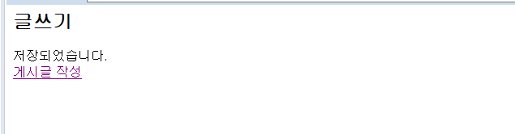
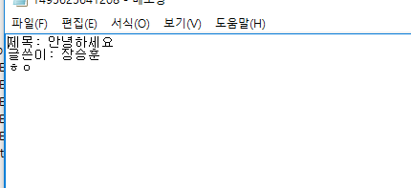
Response 이해
Start

Slide 12
게시판
<%@page contentType="text/html; charset=euc-kr"%>
<%@page import="java.io.*"%>
<HTML>
<HEAD>
<TITLE>파일 목록</TITLE>
</HEAD>
<BODY>
<%
BufferedReader reader = null;
try {
String p = "C:\\Users\\wkdtn\\workspace\\.metadata\\.plugins\\org.eclipse.wst.server.core\\tmp0\\wtpwebapps\\pratice\\WEB-INF\\bbs";
String [] listing = new File(p).list();
for(String str : listing){
%>
<a href="fileRead_new.jsp?text=<%=str %>" class="btn" >
<i class="icon-plus"></i> <%= "내용 :" + str + "<br>"%>
</a>
</form>
<% }
}
catch (FileNotFoundException fnfe) {
out.println("파일이 존재하지 않습니다.");
}
catch (IOException ioe) {
out.println("파일을 읽을 수 없습니다.");
}
finally {
try {
reader.close();
}
catch (Exception e) {
}
}
%>
</BODY>
</HTML>
Start

Slide 13
게시판
</form>
<% }
}
catch (FileNotFoundException fnfe) {
out.println("파일이 존재하지 않습니다.");
}
catch (IOException ioe) {
out.println("파일을 읽을 수 없습니다.");
}
finally {
try {
reader.close();
}
catch (Exception e) {
}
}
%>
</BODY>
</HTML>
Start

Slide 14
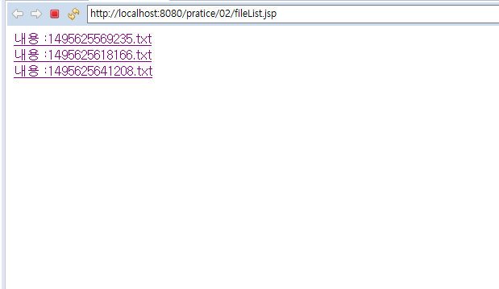
게시판
Start

Slide 15
게시판
<%@page contentType="text/html; charset=euc-kr" %>
<%@page import="java.io.*" %>
<HTML>
<HEAD><TITLE> 파일 읽기</TITLE></HEAD>
<BODY>
<%
BufferedReader reader = null;
try {
String s ="/WEB-INF/bbs/";
String t= request.getParameter("text");
String st=s+t;
String filePath = application.getRealPath(st);
reader = new BufferedReader(new FileReader(filePath));
while (true) {
String str = reader.readLine();
if (str == null)
break;
out.println(str + "<BR>");
}
Start

Slide 16
게시판
}
catch (FileNotFoundException fnfe) {
out.println("파일이 존재하지 않습니다.");
String t= request.getParameter("text");
out.println(t);
}
catch (IOException ioe) {
out.println("파일을 읽을 수 없습니다.");
}
finally {
try {
reader.close();
}
catch (Exception e) {
}
}
%>
</BODY>
</HTML>
Start

Slide 17
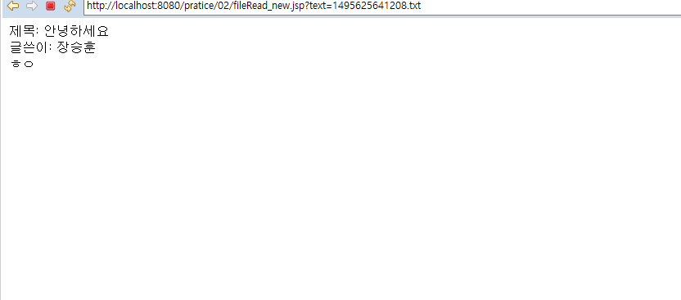
게시판
Start

Slide 18
게시판 보완
<%@page contentType="text/html; charset=UTF-8"%>
<%@page import="java.io.*"%>
<!DOCTYPE html>
<html>
<head>
<meta http-equiv="Content-Type" content="text/html; charset=utf-8">
<meta name="viewport" content="width=device-width, initial-scale=1">
<link rel="stylesheet"
href="https://maxcdn.bootstrapcdn.com/bootstrap/3.3.7/css/bootstrap.min.css">
<script
src="https://ajax.googleapis.com/ajax/libs/jquery/3.1.1/jquery.min.js"></script>
<script
src="https://maxcdn.bootstrapcdn.com/bootstrap/3.3.7/js/bootstrap.min.js"></script>
<style>
body {
font-family: 굴림체;
}
Start

Slide 19
게시판 보완
thead th {
background-color: #eee;
}
tbody tr:hover td {
background-color: #ffe;
cursor: pointer;
}
div {
margin-left: auto;
margin-right: auto;
}
#createButton {
margin-right: auto;
margin-bottom: 4px;
}
</style>
</head>
<BODY>
Start

Slide 20
게시판 보완
<%
BufferedReader reader = null;
try {
String p = "C:\\Users\\wkdtn\\workspace\\.metadata\\.plugins\\org.eclipse.wst.server.core\\tmp0\\wtpwebapps\\pratice\\WEB-INF\\bbs";
String[] listing = new File(p).list();
%>
<div class="container">
<h1>게시판 목록</h1>
<table class="table table-bordered table-condensed">
<thead>
<tr>
<td>제목</td>
</tr>
</thead>
<tbody>
<%
for (String str : listing) {
%>
Start

Slide 21
게시판 보완
<tr>
<td><a href="fileRead_new.jsp?text=<%=str%>" class="btn"> <i
class="icon-plus"></i> <%=str + "<br>"%>
</a></td>
</tr>
<%
}
%>
</tbody>
<form>
<a id="createButton" class="btn btn-primary" href="BBSInput.html">
<i class="glyphicon glyphicon-plus"></i> 게시물 작성
</a>
</form>
</div>
<%
}
Start

Slide 22
게시판 보완
catch (FileNotFoundException fnfe) {
out.println("파일이 존재하지 않습니다.");
} catch (IOException ioe) {
out.println("파일을 읽을 수 없습니다.");
} finally {
try {
reader.close();
} catch (Exception e) {
}
}
%>
</BODY>
</HTML>
Start

Slide 23
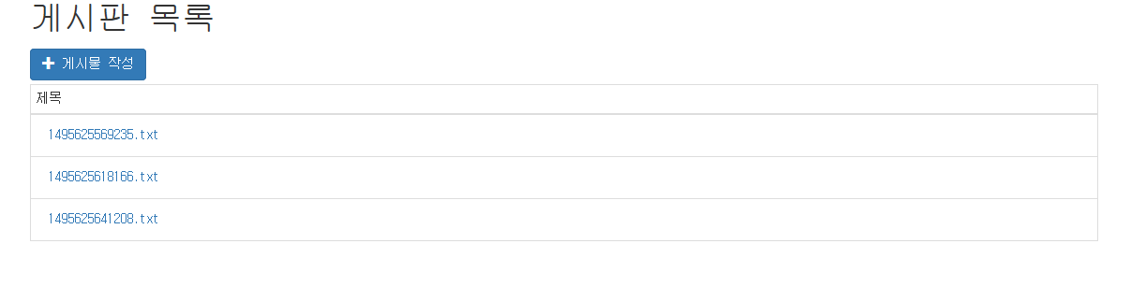
게시판 보완
Start

